Slide 1
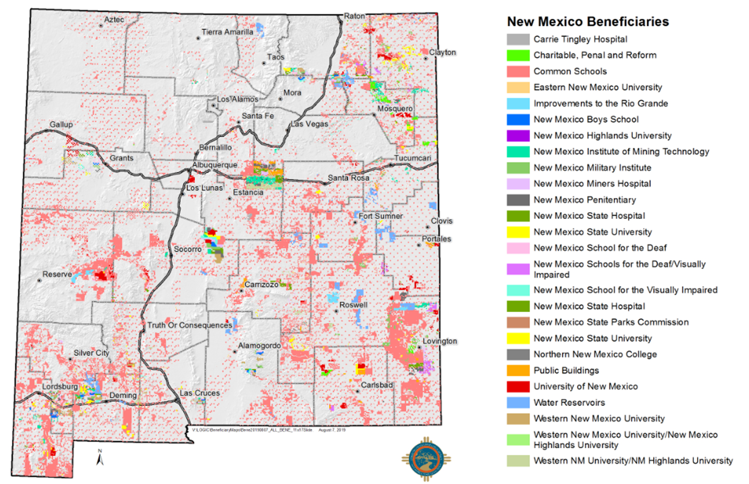
State Land Trust Beneficiaries

Slide 2
NM State Land Office Oil & Gas Industry Day
June 29, 2022 8 am - Noon

Slide 3
Today’s program
8:30 Introductions – Greg Bloom, Assistant Commissioner, Mineral Resources
8:35 Welcome from Commissioner of Public Lands Stephanie Garcia Richard
8:45 – 10 Leases and Coms: Bonding, Assignments, Best Practices… Allison Marks, Oil, Gas and Minerals Division Director
10 – 10:30 Break
10:30 – 11 Compliance & Enforcement: Ari Biernoff, General Counsel
11 – 11:50 Unit Issues: Scott Dawson, Units Manager
11:50 – 12 Water Bureau Issues: Mike McMillan, Petroleum Specialist

Slide 4
Lease issues – Allison Marks
Two Main Topics Today:
  Bonds
  Assignments

Slide 5
Bonding compliance
The SLO began a review of all oil and gas leases to make certain they had a bond (approx. 6,400 leases)
  We are about halfway done with the review as of 6/2022
Bonds are required under the statutory oil and gas leases to be held by the lessee (not the operator)

Slide 6
Who wants this lease?
GOOD OIL MARGINAL OIL | BAD OIL BAD OIL BAD OIL BAD OIL MARGINAL OIL
BAD OIL BAD OIL BAD OIL BAD OIL BAD OIL BAD OIL | GOOD OIL GOOD OIL

Slide 7
Record Title Assignments
Taking a lease via assignment is a business decision
Q: What forms are required to submit a Record Title Assignment?
A: The Record Title of Assignment of Oil and Gas Lease Form (must be submitted in triplicate, 3 originals, executed, dated and notarized) and Lease Assignment Information Coversheet. These forms must be completely filled out. The entity or person acquiring the lease(s) must be bonded with the NM SLO.
Q: How can I research Oil & Gas Leases for land descriptions?
A: You can conduct research on this link: http://web.slo.state.nm.us/Applications/DataAccess/

Slide 8
Record Title Assignments
Q: How do we complete and sign the Record Title Assignment form when there are 2 Assignees or 2 Assignors?
A: Each lessee must sign the Record Title Assignment Form. One lessee will sign the form and the 2nd lessee will sign the Additional Signature Block form that applies. These forms are on the website under Oil & Gas Forms for both the Assignees and Assignors.
Q: What is the filing fee?
A: Filing fees are normally $100 per lease; however, if assignor’s execution date is more than 100 days from the date filed the late filing fee increases to $250 per lease.
Q: Can the Assignor sign one form and the Assignee sign a separate form, then we submit the forms together as one assignment?
A: No, only one form can be submitted.

Slide 9
Record Title Assignments
Q: What if the current lessee is deceased? What do we do?
A: Before the assignment can be submitted, MI documents must be filed and approved. The following supporting documents are required for a deceased persons/estate:
  A certified copy of any applicable death certificate(s)
  Evidence of who is signing for the estate (e.g. letters testamentary, trustee of trust etc.)
  Probated will, if applicable
  If the estate is closed, or many estates are involved, these assignments may become quite complex and may require multiple copies of various instruments and proof of heirship etc. Please feel free to work with us.

Slide 10
Record Title Assignments
Q: What if an entity is no longer in business and sold all their assets, who can sign on behalf of the entity?
A: An officer of that company will need to be tracked down and still has authority to sign.
Q: The entity merged into a different company/had a name change, what do I do?
A: MI forms and all supporting Merger/Name change documentation showing paper trail of how entity name transferred into new company name must be submitted before an assignment can approved.
Q: Will documents/bill of sale filed at the county level suffice as a transfer of record title?
A: No, these documents are not recognized at a state level. A Record Title Assignment must be filed with the NM State Land Office and must be filed and approved in order to be recognized at a state level.

Slide 11
Record Title Assignments
Q: What is required to file a blanket assignment?
A: Only 25 leases are allowed on a blanket assignment, use exhibit provided by the SLO. The assignment must be executed on NMSLO’s form, in triplicate (must be originals) notarized, original signatures.
In addition to the 3 original blanket assignments, you are required to send us a copy of the signed assignment for each lease that is listed on your exhibits.
A $100.00 filing fee is required on each lease for which an assignment of record title is filed. If executed by an Attorney-in-Fact the supporting document granting this authority is required. A copy must be attached to each lease. Filing fees are normally $100 per lease; however, if assignor’s execution date is more than 100 days from the date filed the late filing fee increases to $250 per lease.*
*Fees as of 6/29/2022

Slide 12
INTERNAL CHECK LIST FOR REVIEWING AN ASSIGNMENT WHEN IT IS RECEIVED:
Cover Sheet
Make sure Record Title Assignment Form is submitted in triplicate and correct filing fee has been received.
Make sure “Full” or “Partial” box is selected.
Make sure “From Lease Number” in top right hand corner is completed.
Verify OGIRD numbers entered, are correct and match individual/company name listed.
Make sure address is entered.
Make sure Base Lease and date are entered and correct.
Make sure Legal/Location Description is entered, correct, and matches Make sure execution dates and notary dates are completed and in uniform for both assignee and assignor.
Make sure forms are signed and notarized with notary seal.
If form is signed by an Attorney in Fact, a POA must be submitted with all forms.
Whomever is signing on behalf of the entity, this person’s title must be stated. If this individual is signing on behalf of someone, this documentation must be provided showing signing authority.

Slide 13
EXTERNAL CHECKLIST:
Joint Lease:
Cover Sheet (attached), including contact person if there are questions.
Only one Record Title form should be submitted and an additional signature page should be included to capture additional signature. (These 2 forms are attached)
If Assignee or Assignor portion is signed by an attorney, a POA must be provided. The POA must be submitted for every Record Title Assignment submitted (In triplicate)
Whomever is signing on behalf of the entity, this person’s title must be stated. If this individual is signing on behalf of someone, this documentation must be provided showing signing authority.
The execution dates must be in uniform.
If a name change/merger has occurred, all documents must be included showing path to current name (a previously filed MI number may be referenced in a cover letterhead).
  If MI’s have not been submitted to SLO showing a name change/merger, these documents must be filed prior to submitting the Record Title Assignments.

Slide 14
EXTERNAL CHECKLIST:
Single Lease:
Cover Sheet (attached), including contact person if there are questions.
If Assignee or Assignor portion is signed by an attorney, a POA must be provided. The POA must be submitted for every Record Title Assignment submitted (In triplicate)
Whomever is signing on behalf of the entity, this person’s title must be stated. If this individual is signing on behalf of someone, this documentation must be provided showing signing authority.
The execution dates must be in uniform.
If a name change/merger has occurred, all documents must be included showing path to current name (a previously filed MI number may be referenced in a coverletter).
  If MI’s have not been submitted to the SLO showing a name change/merger, these documents must be filed prior to submitting the Record Title Assignments.

Slide 15
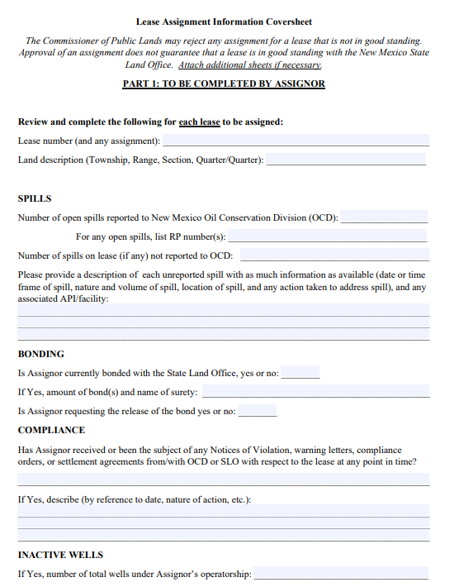
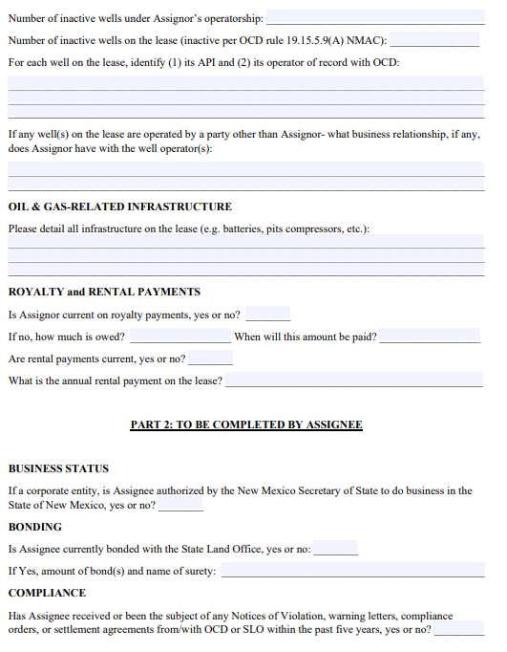
COversheet

Slide 16
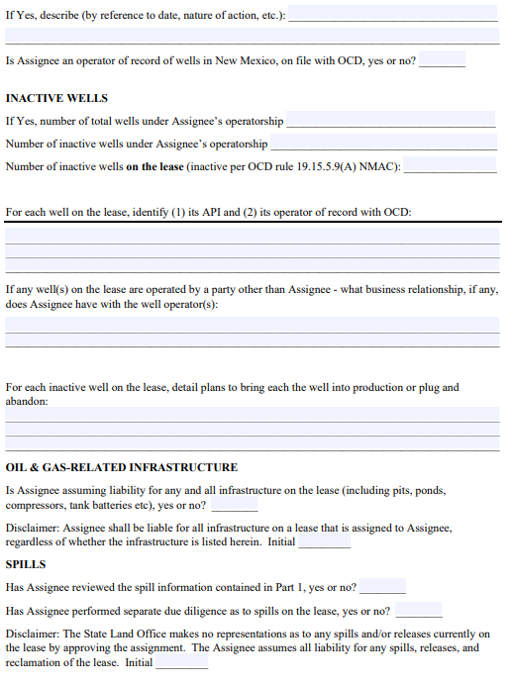
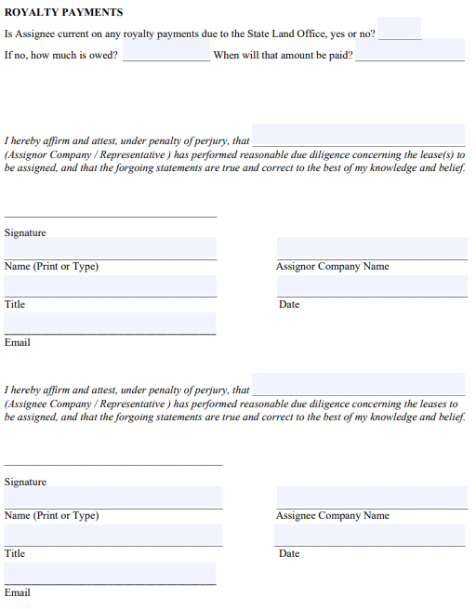
Coversheet Continued

Slide 17
Lease Assignment Information Coversheet
Coversheet should be submitted with any assignment submitted to SLO
  Form can be found on the SLO website under the “Forms” tab under “Oil & Gas”: https://www.nmstatelands.org/wp-content/uploads/2022/01/Lease-Assignment-Information-Coversheet-1-20-2022.pdf
If a blanket assignment is submitted, a blanket coversheet can be submitted (covering the same number of assignments in the blanket assignment) with a spreadsheet/exhibit for each lease that is part of the blanket assignment
The coversheet covers the same information that the SLO staff reviews and is a means to serve as an early alert system for lessees:
  Royalty issues—is the assignor current on all royalty issues?
  Bonding—are both parties bonded?
  Environmental—are there open spills? Have pits been reclaimed? Infrastructure?
  Inactive wells/compliance—who is operating on the lease? Are wells active? Are there pending violations with OCD? Historical issues that continuously are problematic?
  Rental payments—have they been paid or is the assignee going to obtain a lease that will be terminated or just has been terminated?

Slide 18
Inactive wells
If Yes, number of total wells under Assignor’s operatorship: Insert the total number of wells the Assignor operates with OCD
Number of inactive wells under Assignor’s operatorship: Insert the total number of inactive wells the Assignor has with OCD, including wells under an ACOI (it would be helpful to indicate there is an ACOI, however)
Number of inactive wells on the lease (inactive per OCD rule 19.15.5.9(A) NMAC): Insert the number of inactive wells on this particular lease here. If there are inactive wells from more than one operator, all inactive wells should be included.
For each well on the lease, identify (1) its API and (2) its operator of record with OCD: Only the inactive wells need to be identified here.
If any well(s) on the lease is/are operated by a party other than Assignor- what business relationship, if any, does Assignor have with the well(s) operator(s): This should include any wells on the lease operated by someone other than the Assignor.

Slide 19
Other Q & A’s on the Coversheet
What is the Land Office looking for regarding infrastructure?
  Is something a separate business lease or is something (e.g. pit) an on-lease liability that transfers? Does a separate BL need to be obtained? Is the infrastructure dated and need to be closed out (similar to BL renewal).
How far back do I need to detail OCD violations?
  If you’ve had the lease for a long time, we don’t want to place a large burden on lessees. We are really looking to see if something is a recurring issue or if an issue hasn’t been closed out. A ten year “lookback period” is appropriate, although the SLO may ask for more information. We have found open spills from the early to mid-2000s, where the issue is just a matter of a missing document with OCD.
What is the SLO looking at when we look at spills?
  The Land Office is reviewing satellite imagery and does comparative imagery from various years. When a spill is seen, the Land Office reviews the OCD database to determine if the spill has been reported and the status of the spill. A Land Office field representative may then go to the site or the Land Office may directly contact a company.
What bonds do I list?
  Just Land Office bonds (we do not need OCD or BLM bonds listed here).

Slide 20
Communitization Agreements
Com wells must produce every 60 days or the com agreement terminates (with few exceptions)
When the agreement terminates, production is in trespass and the SLO receives 8/8ths royalty
Note the language in P. 9 (P.10 in fed-state) of most com agreements: “This agreement shall not terminate upon cessation of production of communitized substances if, within sixty (60) days thereafter, reworking or drilling operations on the communitized area are commenced and are thereafter conducted with reasonable diligence. As to State Trust Lands, written notice of intention to commence such operations shall be filed with the Commissioner of Public Lands within thirty (30) days after the cessation of such production, and a report of the status of such operations shall be made by the Operator to the Commissioner every thirty (30) days, and the cessation of such operations for more than twenty (20) consecutive days shall be considered as an abandonment of such operations as to any lease from the State of New Mexico included in this agreement.”
  This language is similar to P. 15 reworking provision of statutory lease, but, note this applies to the com agreement and should be invoked for the com.
There is nothing that allows a company to produce a com well before it has a com agreement in place!
  Coms are subject to SLO approval.
Some of the lease title clean up should make getting com signatures easier.

Slide 21
Other best practices
The Land Office looks at the lessee first, as the Land Office has a contractual relationship with the lessee
Know who is operating on your lease! The Land Office will look to you for clean up, P & A, etc.
If you operate on a lease and are not the lessee of record, you want to make certain the lessee complies with all SLO rules in order to not lose the lease
If bringing a case before OCD (e.g. compulsory pooling), make sure the lands are under lease with the Land Office and the lease is bonded
Continue to pay annual rentals!
If you have a question, call us! When an issue first comes up (e.g. well goes down, frac hit, etc) Land Office staff can work through best practices to preserve a lease/well on the front end.

Slide 22
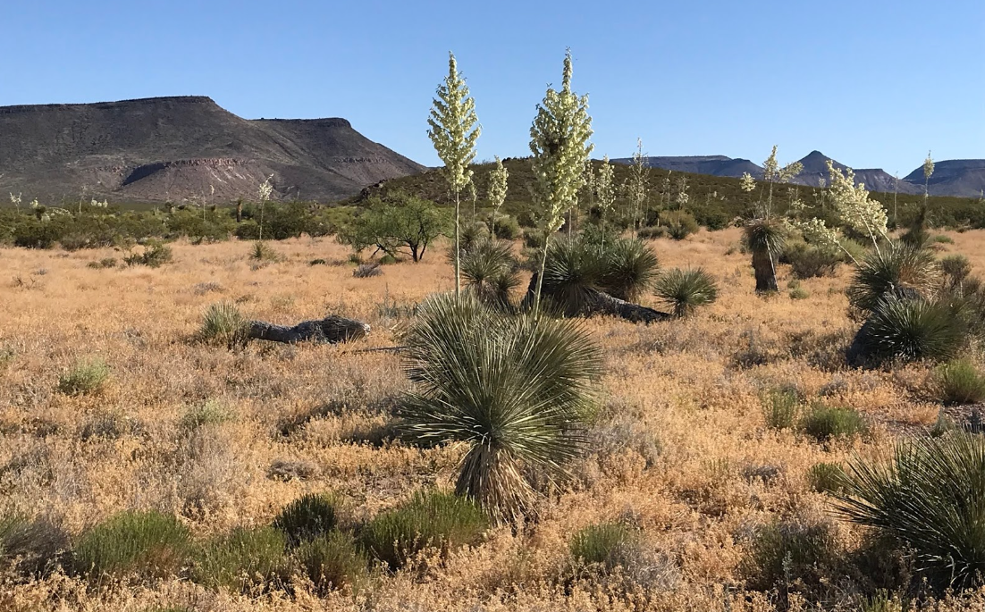
ACCOUNTABILITY & ENFORCEMENT – Ari Biernoff
Purpose: to ensure responsible stewardship of state trust lands for the long-term benefit of the trust
Focus:
  Abandoned wells
  Soil and groundwater contamination
  Debris removal and surface reclamation
Approach:
  Outreach and Education
  Communication
  Settlement
  Litigation
  photo credit: Devon Fletcher
Results: >100 inactive wells plugged; 14 lease sites fully reclaimed

Slide 23
LEASE RIGHTS AND RESPONSIBILITIES
Leases grant lessees EXCLUSIVE rights to develop oil and gas on subject acreage
Leases impose responsibility for environmental damage caused by lease operations
Leases require compliance with applicable laws and rules

Slide 24
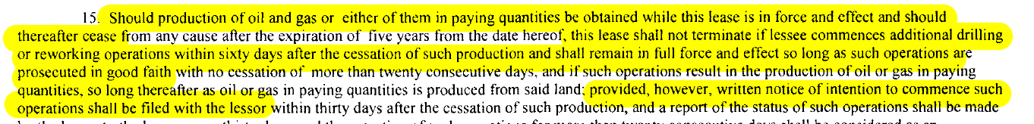
LEASE EXPIRATION VS. CANCELLATION
Leases are perpetual … provided ongoing production in paying quantities
There is an exception to expiration if production stops…
…But there is no all-purpose shut-in provision
Cancellation is a default on a lease obligation and requires prior notice and cure; expiration is automatic

Slide 25
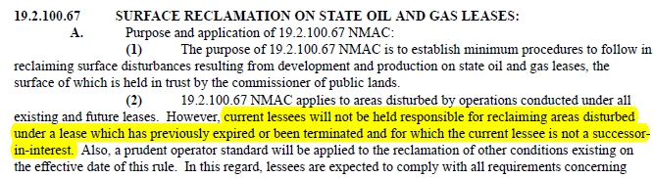
State land office rules on environmental compliance
19.2.100.66 and 19.2.100.67 NMAC
Establish basic requirements for responsible operations during the lifespan of a lease and closeout requirements for an expired or canceled lease
Lessees are not responsible for environmental damage from prior leases on the same acreage…
…but are responsible for damage dating back to previous assignments of the same lease

Slide 26


THE GOOD, THE BAD…
Inactive wells – plugged?
Soil contamination – remediated?
Debris – removed?
Pads and roads – reseeded?
Right of Entry permit required for expired/canceled leases
Communication to grazing lessee and new oil and gas lessee, if any
Coordination of cleanup with SLO remediation team

Slide 27
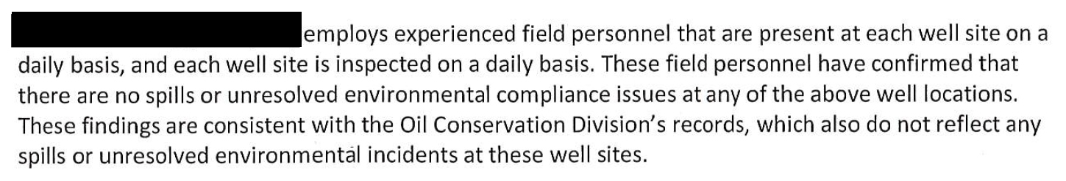
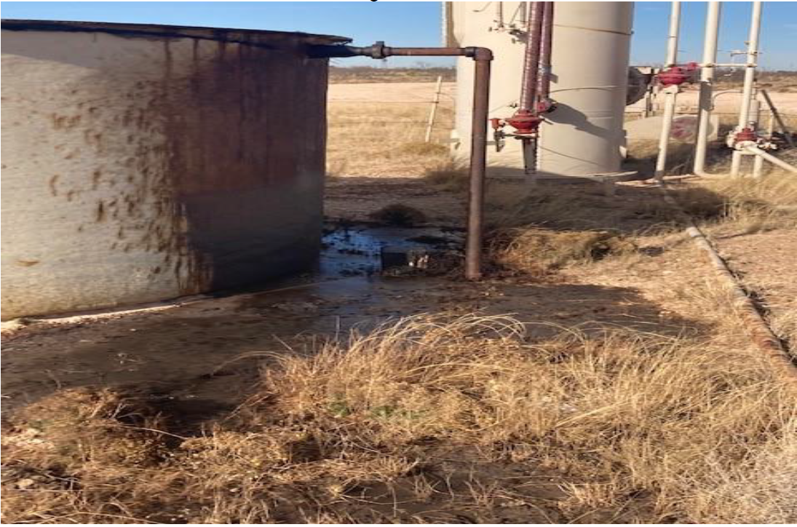
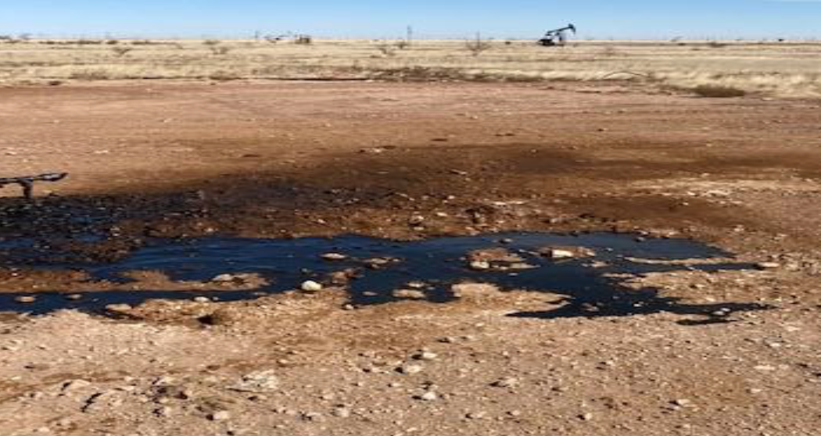

…AND THE UGLY

Slide 28
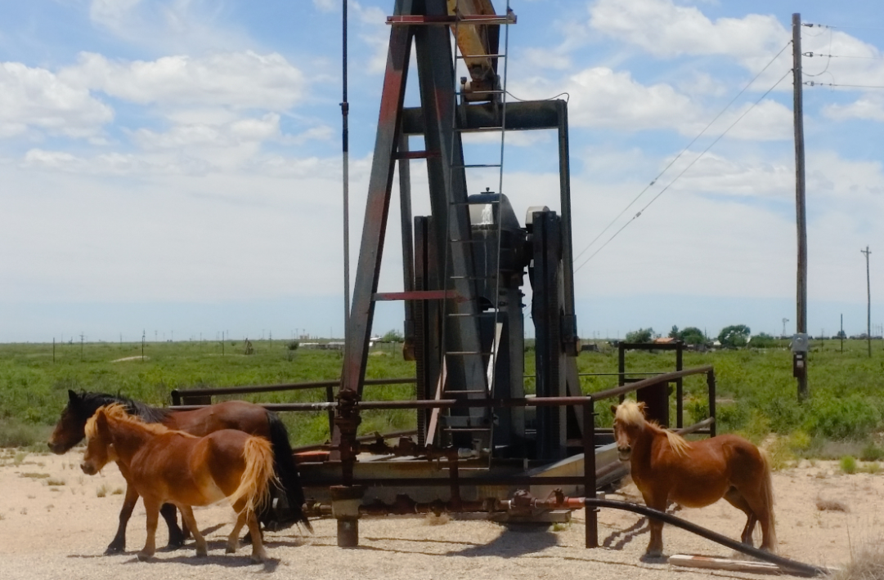
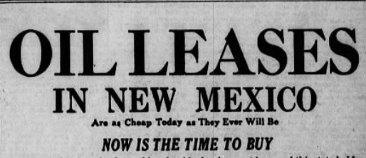
THOUGHTS ON GOOD PRACTICE
Monitor site conditions regularly
Avoid excessive inactive wells
Report spills promptly
Review SLO and OCD rules
Make sure sufficient bonds are in place
Contact us!
  compliance@slo.state.nm.us
                Photo credit: IPANM Wildlife in the Oil Field photo contest (madrid2)

Slide 29
Units – Scott dawson
New Unit Change of Operator Checklist
Revisions to the Requirements for Plans of Development
Un-bonded Leases Within a Unit
Unit/Com Wells

Slide 30
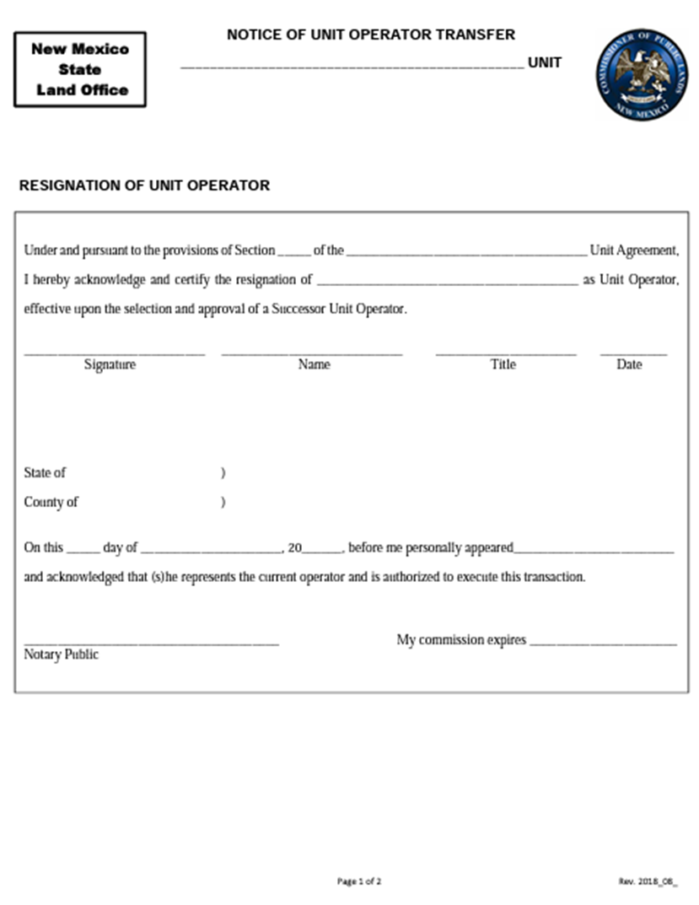
Transfer of Unit Operator Forms
In order for an Operator to transfer ownership of a Unit involving State Lands they must sign and notarize the “Resignation of Unit Operator” form
The newly designated Operator must sign and notarize the “Designation of Unit Operator” form

Slide 31
Change of Operator checklist
In order for a transfer of Unit Operator to be considered by the Commissioner the following information must be tendered:
  Contact information for both the resigning Operator and the Designated Operator in case communication is needed
  Each Unit Transfer must be submitted separately (i.e. if multiple Units are being transferred they need separate submissions)
  An NMOCD approved C-145 well transfer form with all of the wells included in the transfer
  If a merger or acquisition has occurred, then include the instruments and certificates demonstrating the chain of ownership
  A review of any environmental liabilities contained within the Unit including spills, releases, and any wells that need to be plugged and abandoned
    For the spills/releases include the number of spills reported/not reported to the NMOCD, RP numbers for any open spills, and a description of the spill/releases that haven’t been reported to the NMOCD
  A list of all of the wells within the Unit and their status (i.e. active, inactive, needs to be P&A’d, RTP, etc.)

Slide 32
Change of Operator Continued
Before the transfer will be approved by the State Land Office, both the resigning Operator and designate Operator need to attest to the following:
  All environmental rules and regulations pursuant to State Land Office Rules 19.2.100.66 (Surface Operations on State Oil and Gas Leases), 19.2.100.67 (Surface Reclamation on State Oil and Gas Leases) and 19.2.100.69 (Payment of State Royalties) are complied with.
  Resigning Operator has documented and relayed all open surface releases and environmental liabilities to the Designated Operator and included a copy to the NM State Land Office (NMSLO). All open surface releases and environmental liabilities must be addressed to the satisfaction of the NMSLO before the change of operator will be approved by the Commissioner.
  Resigning Operator has documented and relayed all wells that have been plugged and all inactive wells that need to be plugged and abandoned, or returned to production, to the NMSLO and Designated Operator. All inactive wells must be addressed to the satisfaction of the NMSLO before the change of operator will be approved by the Commissioner.
  All production reports filed with the NMOCD are up-to-date and that the designated Operator is aware of the number of inactive wells in the Unit.
  All of the information provided has been reviewed by both parties and is accurate.
  The newly designated Operator must adhere to all rules and regulations pursuant to Rule 19 NMAC - State Trust Lands Rules.

Slide 33
Unit plans of development
Starting with the 2023 Unit Plans of Development, the State Land Office is going to align our requirements closely with the new BLM template for POD’s.
Additions to the template will include, but are not limited to,
  Production graphs for each reservoir being developed within the Unit with legible legends
  For flooding operations, an analysis of current flood results and conclusions compared to initial expected results
  Maps that include structural and geologic interpretations
  For secondary recovery operations, a graph of Cumulative Production vs. Produced Water Oil Ratio

Slide 34
Un-bonded leases within a unit
The New Mexico State Land Office is making a concerted effort to reduce the number of un-bonded State leases that are still active
Un-bonded leases that are part of a Unit are not immune from being cancelled for lack of bonding
Cancellation of the lease will effect how production within the Unit is allocated and cause complications for Unit Operators
In cases where there is a lease that is lacking a bond, which is part of a Unit, the SLO is actively reaching out to Unit Operators to see if they wish to pursue a record title assignment to avoid cancellation
If the Operator wishes to pursue a record title assignment, they will need to work with the Leasing group to accomplish the task

Slide 35
Unit/Com Wells
The NMSLO has seen an uptick in the submission of wells that are drilled across a Unit boundary that require a Communitization Agreement
We ask Operators to notify us of these situations before the wells are drilled and provide the Land Office with reasoning for the occurrence
Note that depending on the type of Unit that they enter, they may have to go through the commercial determination process and re-allocate production once a well is deemed commercial

Slide 36
Water bureau – Mike Mcmillan
WATER BUREAU CONTACTS
Faith Crosby: Water Bureau Manager
  505-827-5849 fcrosby@slo.state.nm.us
David Gallegos: Water Resource Analyst
  505-476-3078 dgallegos@slo.state.nm.us
Mike McMillan: Petroleum Specialist
  505-827-5788 mmcmillan@slo.state.nm.us

Slide 37
Water bureau – Mike Mcmillan
SWD and Water Wells Drilled on NMSLO Trust Acreage Require an Easement When:
  NMSLO Trust acreage is comprised of surface and subsurface ownership (Most common)
  NMSLO Trust acreage is comprised of surface acreage only (Very rare)

Slide 38
Water bureau
The Water Bureau performs technical review of Salt Water Easements, both new applications and renewals
  Initial step
    Primarily based on Oil Conservation Division Well Files:
      Look at casing design
      MIT - Make sure that a current MIT is on file with the OCD
      Look at C-115 injection volumes
      Check to determine if any spills occurred at the easement on the OCD Well Page and Incident Report
    GIS and Google Earth Maps
      Compare the injection interval and surrounding oil and gas production in the same formation based on OCD data
      GIS and Google Earth images to identify spills at the easement
      Examine TexNet and New Mexico Bureau of Geology and Mineral Resources seismic data in New Mexico and West Texas daily to identify earthquakes.

Slide 39
Water bureau
  Next step is a field report request after the Well File and the GIS and Google Earth images are reviewed to identify any spills and determine what improvements are located at the easement
  Final step is drafting an easement contract based on OCD Well files, Google Earth and GIS Images, and the field report

Slide 40
Contact information
Greg Bloom, gbloom@slo.state.nm.us, 505-827-5746
Allison Marks, amarks@slo.state.nm.us, 505-827-5745
Ari Biernoff, abiernoff@slo.state.nm.us, 505-827-5786
Scott Dawson, sdawson@slo.state.nm.us, 505-827-5791
Mike McMillan, mmcmillan@slo.state.nm.us, 505-827-5788

